Slide 1

Real-time translation tool
Final Presentation
Guide: Dr. Tomochika Ozaki
アディティ シャルマ
Aditi Sharma
Date - 8th July, 2025

Slide 2
Motivation
Tourists or researchers face difficulty navigating environments with foreign languages in foreign spaces. This acts as a roadblock.
The translation tools available in the current market, don’t offer real-time translation offline. Google lens or google image search for translation offers offline support but for higher accuracy it also requires online translation using its GNMT (Google Neural Machine Translator). With the increased use of AR in every field, the integration of the two would be a great addition to the already existing features and further reduce the need for handheld devices and replace them with head mounted devices with extensive features.

Slide 3
Objective
To solve this problem the proposed solution should solve the following problems:
Use live camera feed to get japanese text from surroundings.
Offer Offline translations
Offer Speedy translations
Overlays the text onto the original feed.

Slide 4
System Architecture
Video Capture from camera
Text Detection (OCR)
Overlay on Display
Translation
Note: This is process is repeated for every 5th frame of the video capture, so every captured frame goes through this pipeline.

Slide 5
Text detection using OCR
Input
Preprocessing (Image Enhancement)
Convert to grayscale
Enhance contrast using CLAHE - clipLimit* [1.5]
Denoise using Non-Local Means
Sharpen edges (custom kernel) - alpha* [0.9]
Upscale for better recognition, if initial recognition fails.
Final dilation to boost contours
Text Detection (PaddleOCR)
Japanese language model with angle classification
Filters out low-confidence and non-Japanese text
Postprocessing
Sort boxes top-to-bottom, left-to-right
Merge nearby boxes on same line using X/Y thresholds
Note: Grid Search was used on a smaller subset of original dataset to find the best combination of clipLimit and alpha, measured by F1 score.
Preprocessing
OCR
Merging of boxes
Output

Slide 6
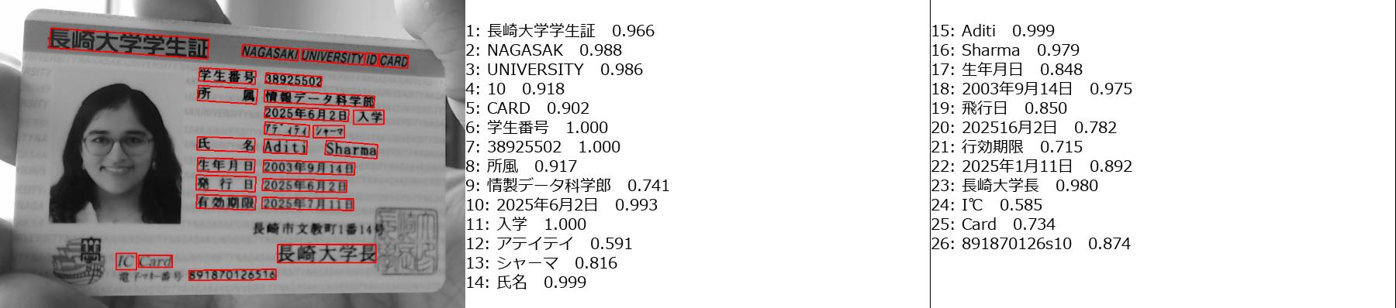
Detection Visualization
Bounding box visualization from live feed

Slide 7
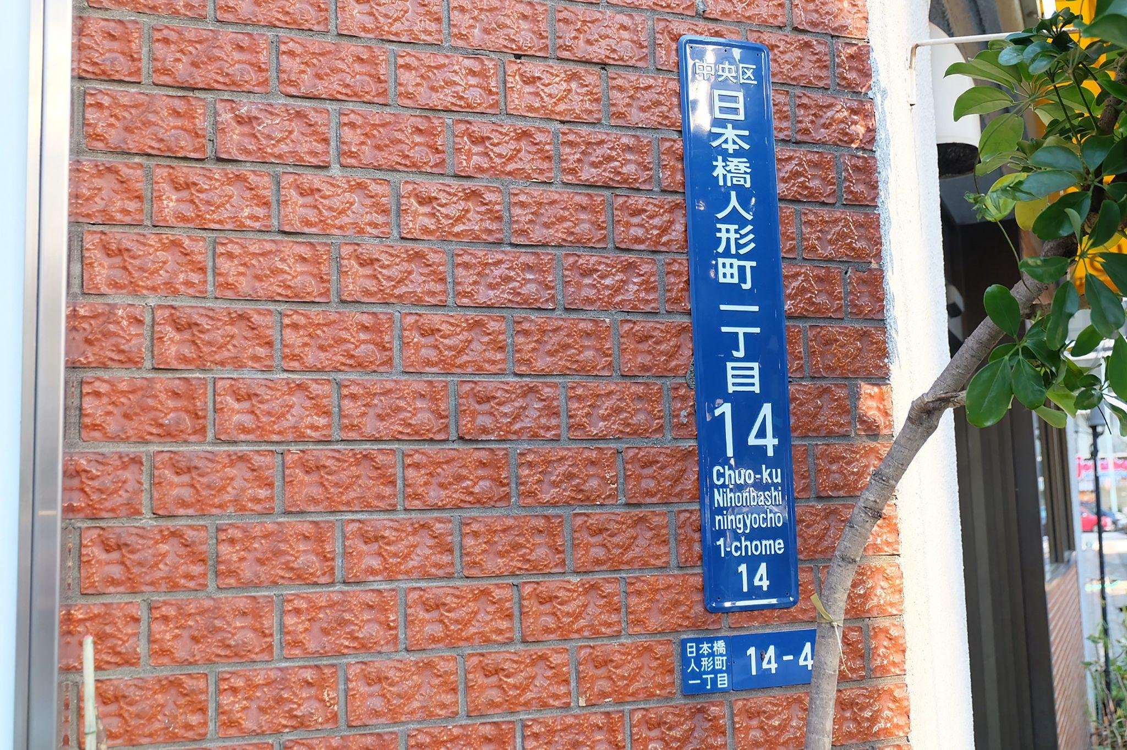
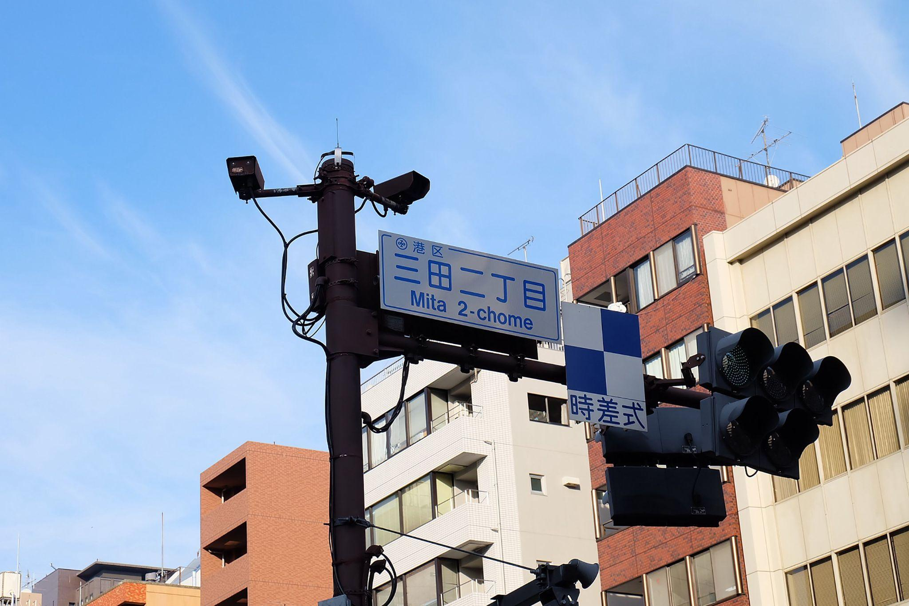
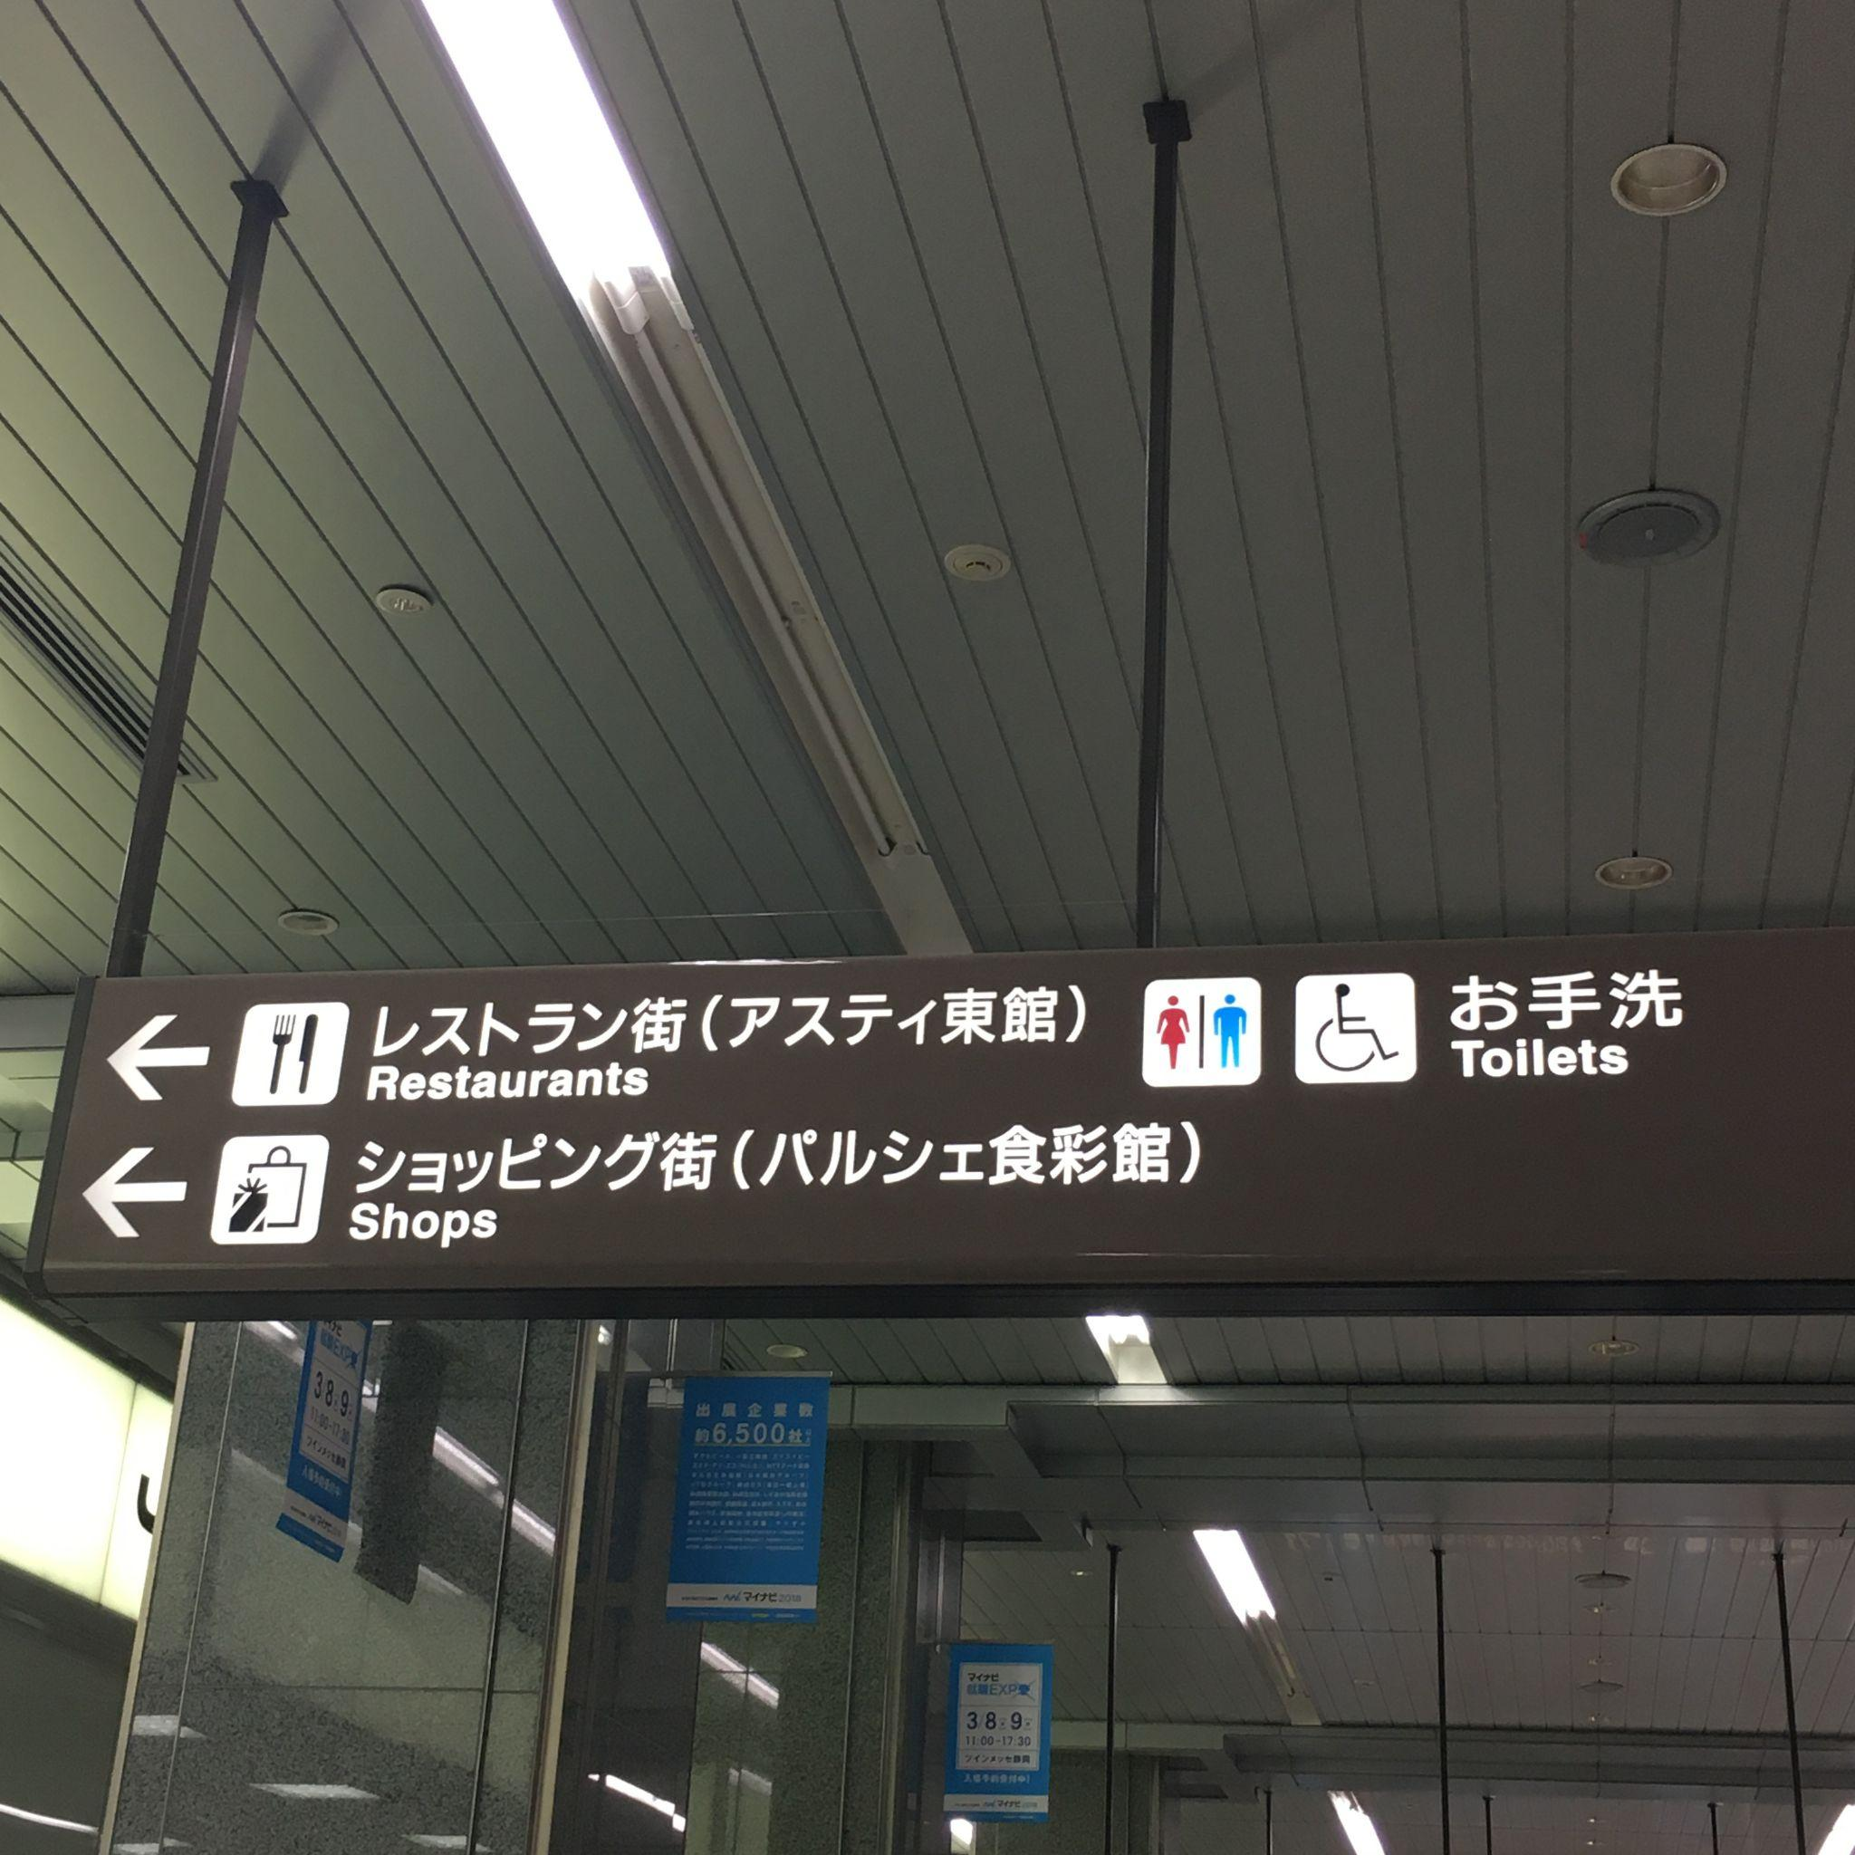
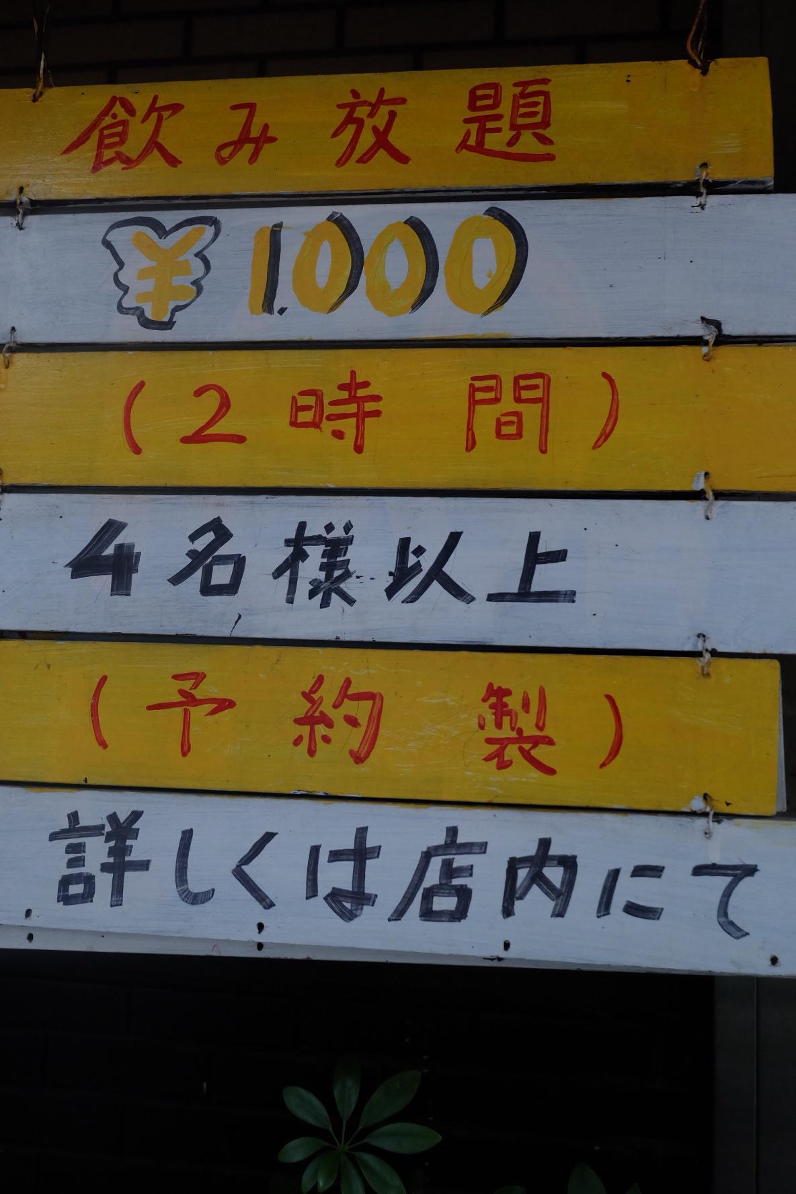
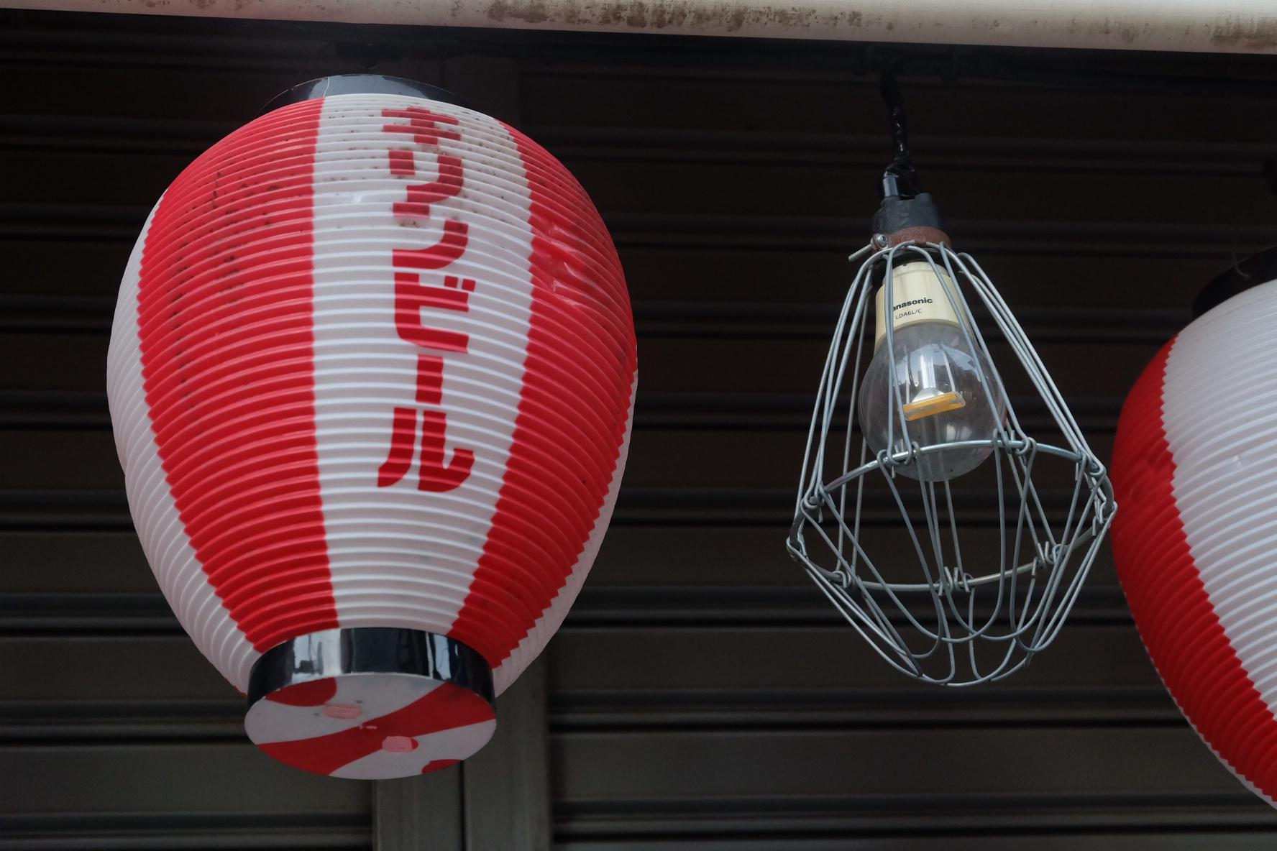
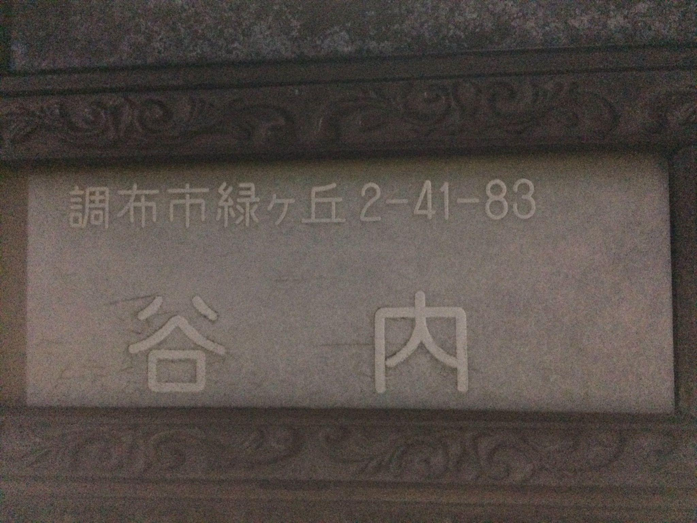
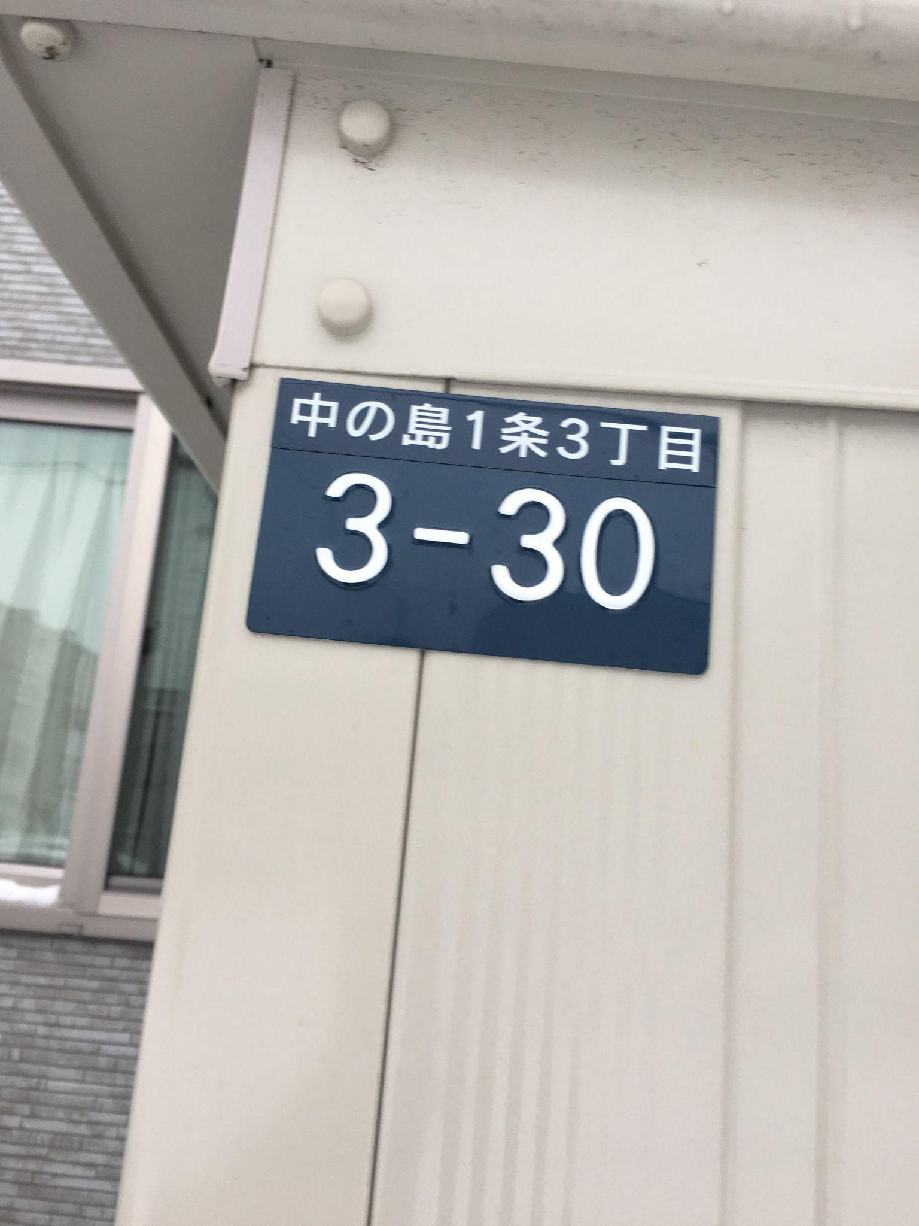
Dataset Used for fine-tuning:
A scene text image dataset with 1000 images containing japanese text.
The images vary in terms of text style and text positions.
The dataset resembles the use case of this translation tool, where the user would need translations of things they happen to see around them.
Some sample images from the dataset

Slide 8
Problems faced in OCR
The images with low confidence had the following issues:
Type 1 - Vertical text
Type 2 - Low Contrast between text and background
Type 3 - Difficult font
Type 4 - Text occupies a very small part of the image
Type 5 - Blurry image
To tackle these problems, some more steps were introduced:
Rotating the bounding boxes for all 4 major orientations (For Type 1).
Applying grayscaling only if contrast is more than threshold (For Type 2).
Resizing images that give zero confidence, to get the text (For Type 4).
Sharpening the image (For Type 5).

Slide 9
F1 and Recall Results on dataset
Techniques | Results
Grayscaling, CLAHE (clip - 1.5), denoising, dilation, sharpening (alpha - 0.9), upscaling, box-wise matching. | TP = 263, FP = 105, FN = 345 Precision = 0.7147 Recall = 0.4326 F1 Score = 0.5389
After Applying the improvement techniques to tackle specific types of images:
F1 score has increased to 0.5389 from 0.4115
Recall has increased to 0.4326 from 0.3244
Precision has also increased to 0.7147 from 0.5627

Slide 10
Text Translation: Japanese to English
Model Overview
Model used: Helsinki-NLP/opus-mt-ja-en
Uses HuggingFace Transformers
It is a MarianMT model, pretrained for Japanese to English translation.
Methodology
OCR-detected Japanese text
Ground Truth .txt files
OCR .csv file from earlier step
Text is cleaned and tokenized
Translated using the model
Post-processed to remove special tokens.
Input
Cleaning and Tokenization
Translation
Output

Slide 11
Evaluation of Translated Text
Fuzzy Matching:
Textual Similarity (0 to 1)
There were cases of complete similarity also, but the average remained at 0.41.
TER
Translation Edit Rate
This remained high for most of the cases and average was also high around 113.3.
Main cause for poor performance of the translator is breaking of bounding boxes. The boxes defined in the dataset mostly encapsulated a sentence correctly into a single box, but OCR broke a single sentence into multiple parts leading to bad contextualization and hence bad translation.
To tackle this box merging was used which did improve the performance.

Slide 12
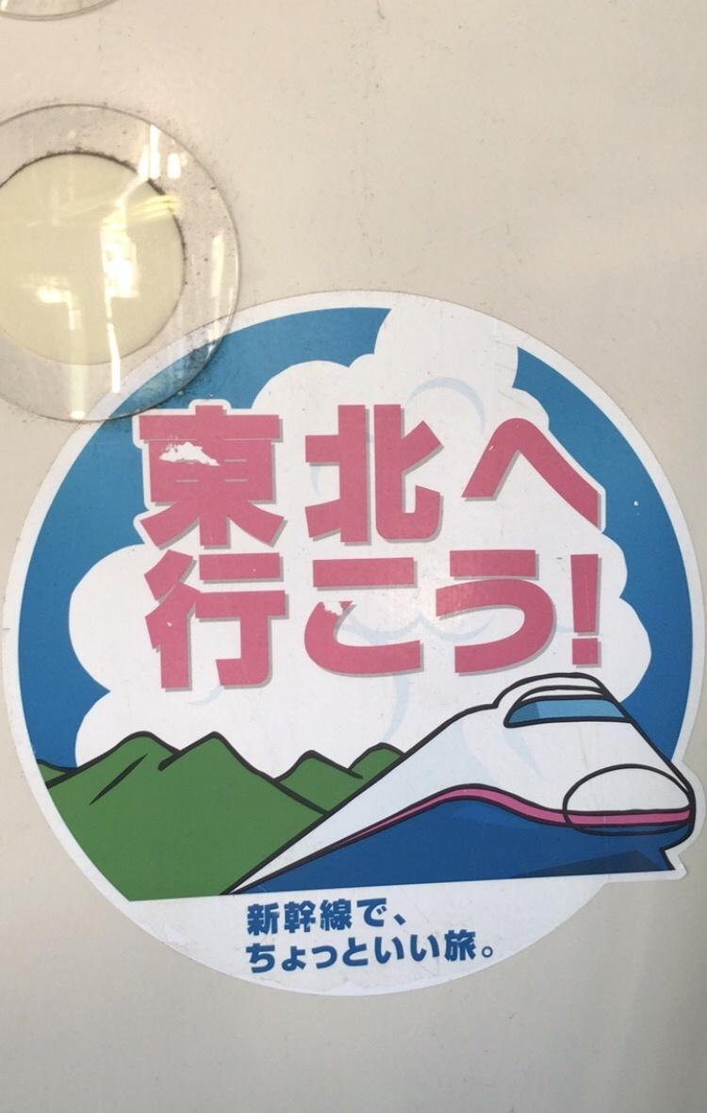
Few Examples of GT vs OCR - Good
Fuzzy_Avg: 0.815
GT Text Lines (3):
Tohoku
Let's go!
Chiyotsu is a great trip.
OCR Text Lines (4):
Tohoku
Let's go!
On the Shinkansen
A good trip

Slide 13
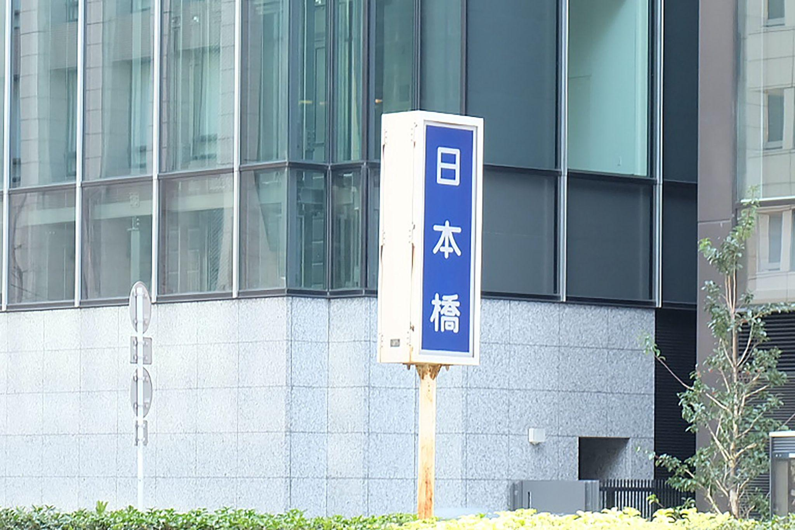
Few Examples of GT vs OCR - Bad
Fuzzy_Avg: 0.154
GT Text Lines (1):
Nipponbashi
OCR Text Lines (2):
Roku
Leave the board

Slide 14
Where does the problem lie?
After observing various instances where the performance was bad, few things can be noted:
Performance of OCR affects the translations.
OCR performs poorly on complex font styles and vertical text, this is due to imbalance in the training material, where vertical text instances were lower.
Breakage of long phrases due to tokenization changes context and leads to bad translation.

Slide 15
Live Feed Overlay
Capture frame from webcam using OpenCV
Preprocess the frame:
Grayscale, CLAHE, denoise, sharpen, dilate
Upscale for better OCR
OCR with PaddleOCR.
Translate detected text using MarianMT model
Overlay translated text on live video with bounding boxes and blurring
Input (Webcam)
Pre-processing
OCR
Translation
Note: The above pipeline is run 5 frames per second and each of these frames goes through the same process. This is done to manage the latency or time gap generated due to OCR and translation.
This helps to avoid overloading the CPU and also maintains a real-time performance.
Overlay on Frame

Slide 16
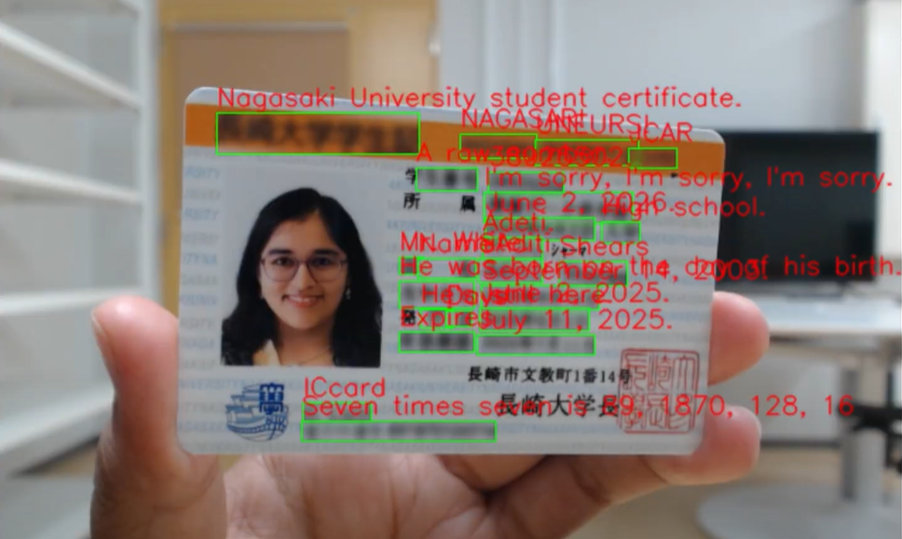
Live Feed Overlay - few snapshots

Slide 17
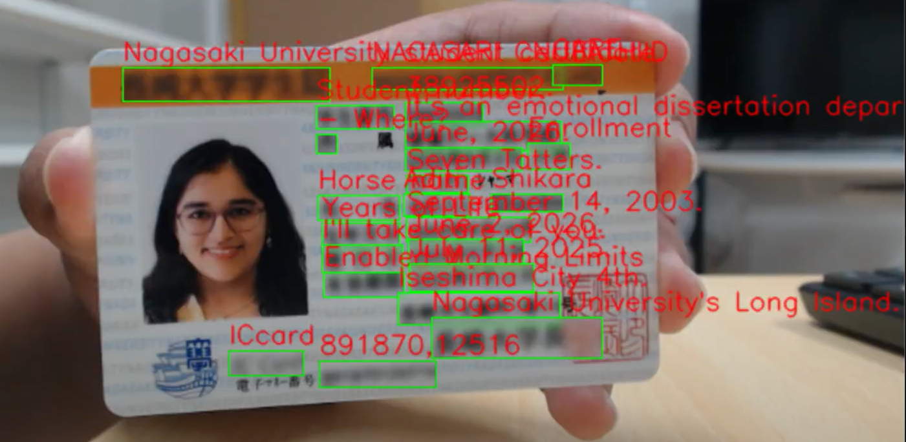
Live Feed Overlay - few snapshots

Slide 18
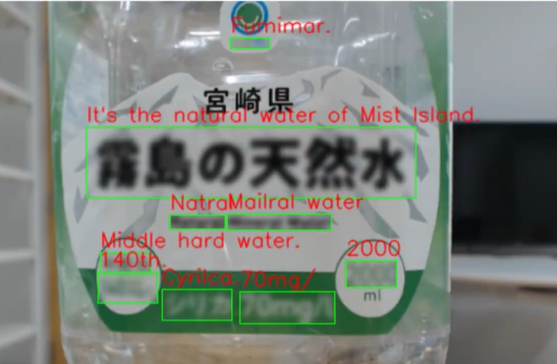
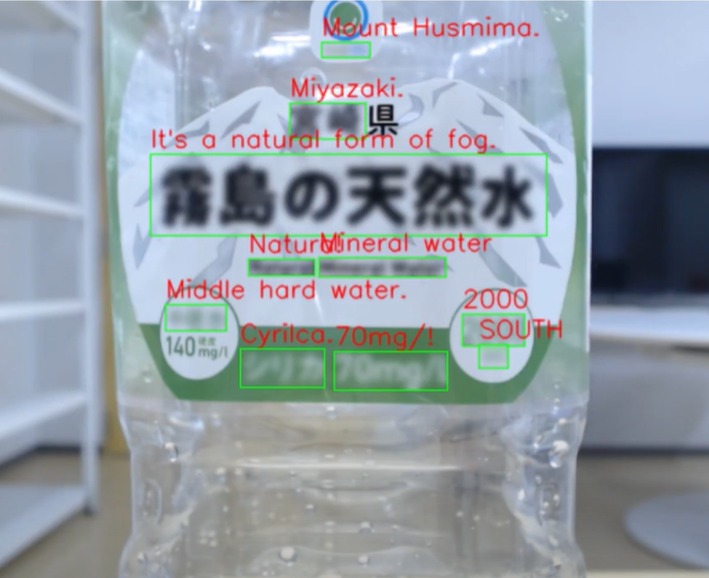
Live Feed Overlay - few snapshots

Slide 19
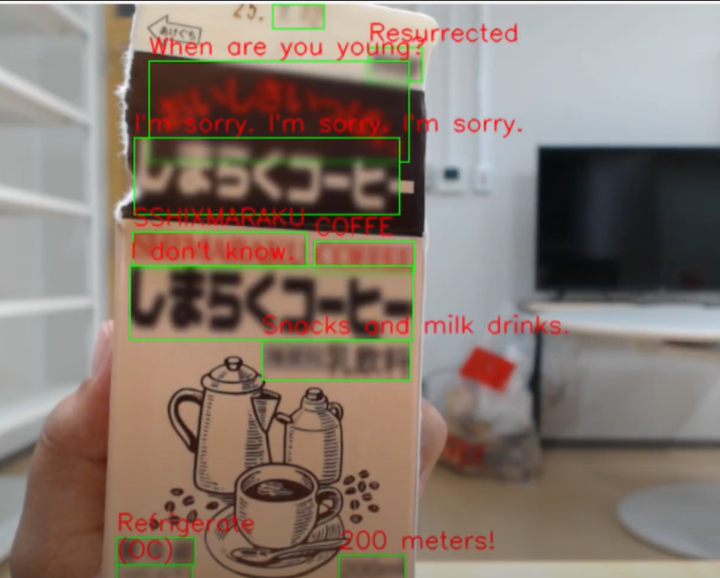
Live Feed Overlay - few snapshots

Slide 20

Issues with live feed Overlay
The current interface is CPU-only, so the OCr and translation are slower and the overlay rate is of 5 FPS.
To maintain a functional overlay and avoid overloading the system translates every 5th frame of a second, this leads to a choppy overlay.
https://drive.google.com/file/d/1jmBDYsDgS3Wkacu-j4LboWHjkddsHiKP/view?usp=drivesdk

Slide 21
Possible methods to Improve Overlay
Using GPU-enabled OCR and translation to provide better processing speed.
Optimizing image pre-processing pipeline more, removing steps like dilation.
Use quantized model for translation and use caching.
Using of adaptive frame skipping instead of predefined interval.

Slide 22
Future Work and Enhancements
Extension to mobile device and HMDs
Expansion to multiple languages and self detection of language.
Merging with TTS (Text-to-Speech) feature for accessibility.
Shift to AR integration by allowing user to select text region by hand gestures.
Improve robustness for bad OCR cases like curved and vertical text or stylised font.
Explore lighter models like TinyTranslation after achieving a more robust OCR.

Slide 23
Acknowledgement
I would like to sincerely thank the School of Information and Data Sciences, Nagasaki University, for providing this research internship opportunity, I have learned a lot through this experience.
I am especially grateful to my guide Dr. Ozaki, and my lab mates for their valuable guidance, feedback, and support throughout this project.
This experience has taught me many valuable skills and lessons.

Slide 24
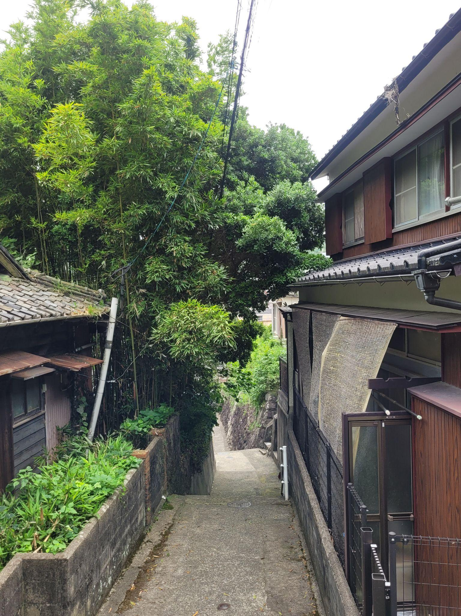
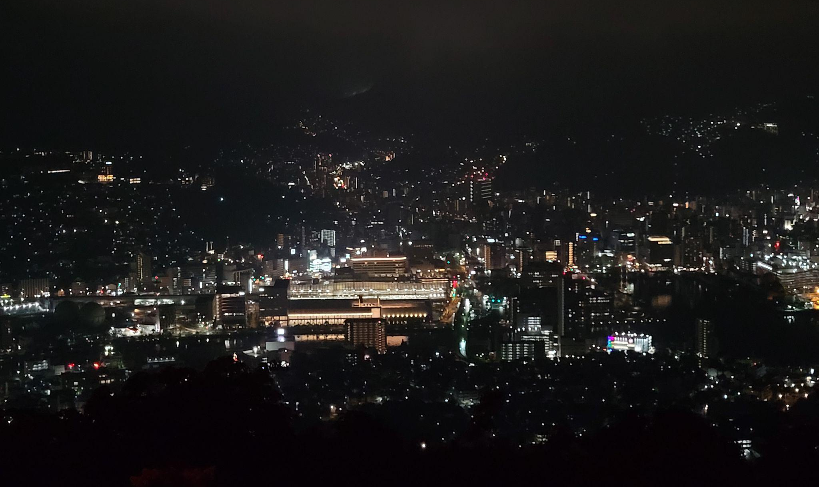
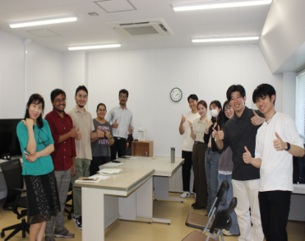
Beyond The Lab: My time in Nagasaki
Along with my work at the lab, I had a very good time in Nagasaki.
We explored the city and met with fellow japanese students who made us feel right at home.
The japanese classes were also very valuable and like a break from regular lab work.
Beyond academics, I experienced the rich history, serene environment, and welcoming community of Nagasaki. This internship broadened my technical skills, global perspective, and appreciation for intercultural collaboration.

Slide 25
Thank you
アディティ シャルマ
Aditi Sharma
Date - 8th July, 2025

